Slide 1

LAB 0
Setup

Slide 2
CHECKLIST
Anaconda
IDE
Repository
>= 5.3
Python 3.6
VS Code (or Atom, …)
Jupyter
https://github.com/
CUDA
CUDA 9

Slide 3
AI UPC Workshop – Deep Learning
Initial Setup
First of all, please do install Anaconda in your machine
Windows version here.
Linux versión here.
MacOS X version here.
Go to the .\scripts folder and run the script that will perform the environment setup:
environment.bat (if you are running Windows)
./environment.sh (for you, Linux folks)
Once the script finishes running, that environment will be active. The name of the environment is aitech18-deeplearningworkshop, in case you want to actívate it manually.
If you plan on using GPU – and you should! – install the CUDA toolkit from this link to the NVIDIA web page.
Run the “00 - SmokeTest.py” to check that the environment and the dependencies have been properly setup. The output will show the version of the Tensorflow and Keras distribution, as well as the number of CPUs and GPUs available in your machine

Slide 4
Deep Learning with Tensorflow

Slide 5
DEEP LEARNING
Machine Learning
Based on Neural Networks
More than one hidden layer (Deep Models)

Slide 6
TensorFlow
Interface for expressing machine learning models
Why?
Multi-platform
Implementation for executing such models
Handles multiple CPUs and GPUs

Slide 7
TensorFlow
Express a numeric computation as a graph
Graph nodes are operations which have any number of inputs and outputs
Graph edges are tensors which flow between nodes
Development in Python

Slide 8
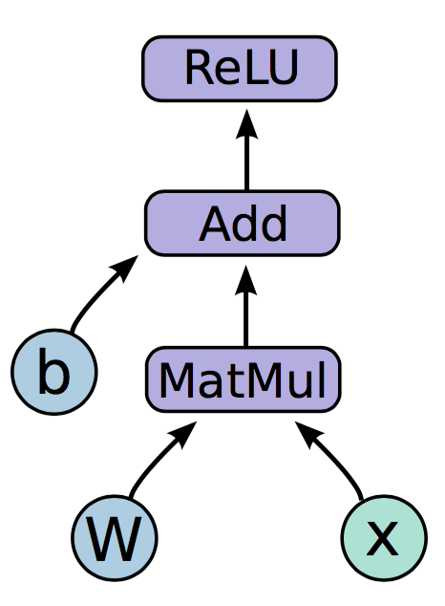
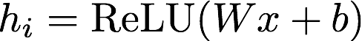
TensorFlow

Slide 9
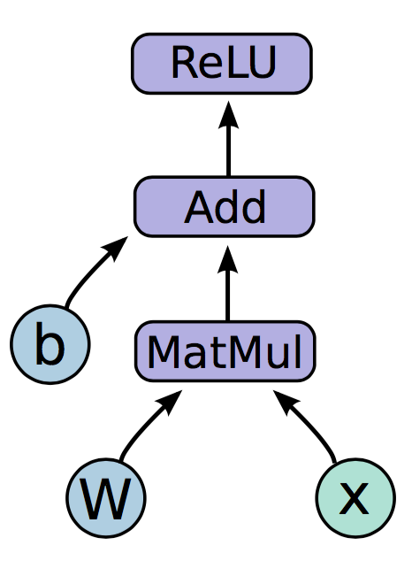
TensorFlow
Variables:
Nodes which emit their value as output
State is persisted, and retained across multiple executions of the graph
Examples: parameters

Slide 10
TensorFlow
Placeholders:
Values are fed at execution time
Examples: inputs, hyper-parameters

Slide 11
TensorFlow
Operations:
Perform the specific operation with the tensor input stream
Examples: MatMul, Add, ReLU

Slide 12
TensorFlow – Graph Code
import tensorflow as tf b = tf.Variable(tf.zeros((100,))) W = tf.Variable(tf.random_uniform((784, 100), -1, 1)) x = tf.placeholder(tf.float32, (None, 784)) h_i = tf.nn.relu(tf.matmul(x, W) + b)

Slide 13
TensorFlow – Graph Execution
Session:
Once we have defined our graph, we need to execute it
We can deploy the graph to a session
These sessions can be binded to an execution context (GPU, CPU, …)

Slide 14
TensorFlow – Execution Code
import tensorflow as tf b = tf.Variable(tf.zeros((100,))) W = tf.Variable(tf.random_uniform((784, 100), -1, 1)) x = tf.placeholder(tf.float32, (None, 784)) h_i = tf.nn.relu(tf.matmul(x, W) + b)
sess = tf.Session() sess.run(tf.initialize_all_variables()) sess.run(h_i, {x: np.random.random(64, 784)})

Slide 15
LAB 1
TensorFlow Operations

Slide 16
TensorFlow 2.0
Eager Execution as default
No need to add tf.enable_eager_execution()
Blocks or Functions can be defined to be executed in graph mode
Less conventions, more object-oriented and pythonic design
Variable_scope removed
Clean up in libraries and contrib

Slide 17
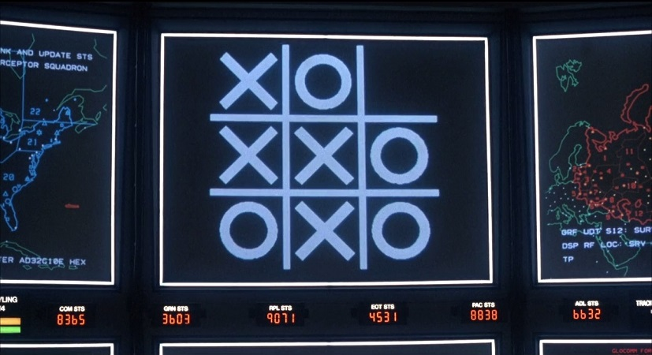
SHALL WE PLAY A LITTLE GAME?

Slide 18
A SIMPLE EXAMPLE
0 | 0 | 0 | 0 | 0 | 0 | 0 | 0 | 0
0 | 1 | 0 | 0 | 0 | 0 | 0 | 1 | 0
0 | 0 | 1 | 0 | 0 | 0 | 1 | 0 | 0
0 | 0 | 0 | 1 | 0 | 1 | 0 | 0 | 0
0 | 0 | 0 | 0 | 1 | 0 | 0 | 0 | 0
0 | 0 | 0 | 1 | 0 | 1 | 0 | 0 | 0
0 | 0 | 1 | 0 | 0 | 0 | 1 | 0 | 0
0 | 1 | 0 | 0 | 0 | 0 | 0 | 1 | 0
0 | 0 | 0 | 0 | 0 | 0 | 0 | 0 | 0
f(x)
“X”
0 | 0 | 0 | 0 | 0 | 0 | 0 | 0 | 0
0 | 0 | 0 | 1 | 1 | 1 | 0 | 0 | 0
0 | 0 | 1 | 0 | 0 | 0 | 1 | 0 | 0
0 | 1 | 0 | 0 | 0 | 0 | 0 | 1 | 0
0 | 1 | 0 | 0 | 0 | 0 | 0 | 1 | 0
0 | 1 | 0 | 0 | 0 | 0 | 0 | 1 | 0
0 | 0 | 1 | 0 | 0 | 0 | 1 | 0 | 0
0 | 0 | 0 | 1 | 1 | 1 | 0 | 0 | 0
0 | 0 | 0 | 0 | 0 | 0 | 0 | 0 | 0
f(x)
“O”

Slide 19

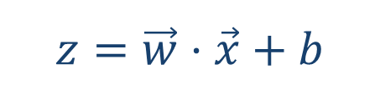
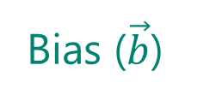
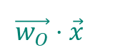
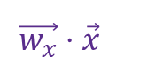
A SIMPLE EXAMPLE
81 values ($\vec{x}$)
Bias ($\vec{b}$)
…
…
1 | 0 | 0 | 0 | 0 | 0 | 0 | 0 | 0
0 | 1 | 0 | 0 | 0 | 0 | 1 | 0 | 0
0 | 0 | 1 | 0 | 0 | 1 | 0 | 0 | 0
0 | 0 | 0 | 1 | 1 | 0 | 0 | 0 | 0
0 | 0 | 0 | 1 | 1 | 0 | 0 | 0 | 0
0 | 0 | 1 | 0 | 0 | 1 | 0 | 0 | 0
0 | 1 | 0 | 0 | 0 | 0 | 1 | 0 | 0
0 | 0 | 0 | 0 | 0 | 0 | 1 | 0 | 0
0 | 0 | 0 | 0 | 0 | 0 | 0 | 0 | 0
9 pixels
Ʃ
Ʃ
9 pixels
Ʃ
Sum (weights x pixels) =
$$\vec{w_{x}}⋅\vec{x}$$
Ʃ
Sum (weights x pixels) =
$$\vec{w_{O}}⋅\vec{x}$$
$$z=\vec{w}⋅\vec{x}+b$$
Notes:
Explicar regresión logística: aplano la matriz, creo los dos vectores, ….

Slide 20
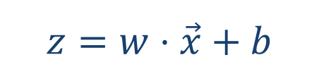
NOW THAT YOU MENTION IT…
$$z=w⋅\vec{x}+b$$

Slide 21
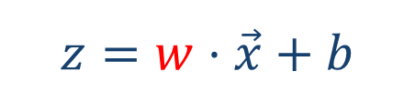
NOW THAT YOU MENTION IT…
$$z=w⋅\vec{x}+b$$

Slide 22
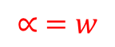
NOW THAT YOU MENTION IT…
$$z=w⋅\vec{x}+b$$
$$∝ =w$$

Slide 23
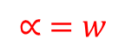
NOW THAT YOU MENTION IT…
$$z=w⋅\vec{x}+b$$
$$∝ =w$$

Slide 24
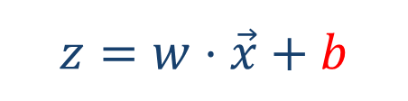
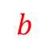
NOW THAT YOU MENTION IT…
$$z=w⋅\vec{x}+b$$
$$b$$

Slide 25
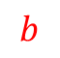
NOW THAT YOU MENTION IT…
$$z=w⋅\vec{x}+b$$
$$b$$

Slide 26
SIGMOID
81 values ($\vec{x}$)
…
…
1 | 0 | 0 | 0 | 0 | 0 | 0 | 0 | 0
0 | 1 | 0 | 0 | 0 | 0 | 1 | 0 | 0
0 | 0 | 1 | 0 | 0 | 1 | 0 | 0 | 0
0 | 0 | 0 | 1 | 1 | 0 | 0 | 0 | 0
0 | 0 | 0 | 1 | 1 | 0 | 0 | 0 | 0
0 | 0 | 1 | 0 | 0 | 1 | 0 | 0 | 0
0 | 1 | 0 | 0 | 0 | 0 | 1 | 0 | 0
0 | 0 | 0 | 0 | 0 | 0 | 1 | 0 | 0
0 | 0 | 0 | 0 | 0 | 0 | 0 | 0 | 0
9 pixels
Ʃ
Ʃ
9 pixels
823,731.01
14,78

Slide 27
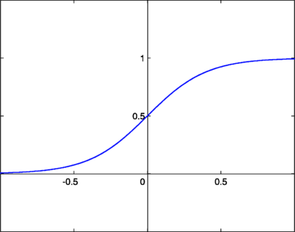
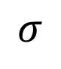
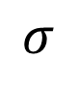
SIGMOID
81 values ($\vec{x}$)
…
…
1 | 0 | 0 | 0 | 0 | 0 | 0 | 0 | 0
0 | 1 | 0 | 0 | 0 | 0 | 1 | 0 | 0
0 | 0 | 1 | 0 | 0 | 1 | 0 | 0 | 0
0 | 0 | 0 | 1 | 1 | 0 | 0 | 0 | 0
0 | 0 | 0 | 1 | 1 | 0 | 0 | 0 | 0
0 | 0 | 1 | 0 | 0 | 1 | 0 | 0 | 0
0 | 1 | 0 | 0 | 0 | 0 | 1 | 0 | 0
0 | 0 | 0 | 0 | 0 | 0 | 1 | 0 | 0
0 | 0 | 0 | 0 | 0 | 0 | 0 | 0 | 0
9 pixels
Ʃ
Ʃ
9 pixels
$$σ$$
$$σ$$
0.78
0.32

Slide 28
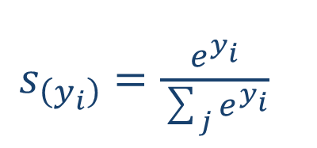
SOFTMAX
81 values ($\vec{x}$)
…
…
1 | 0 | 0 | 0 | 0 | 0 | 0 | 0 | 0
0 | 1 | 0 | 0 | 0 | 0 | 1 | 0 | 0
0 | 0 | 1 | 0 | 0 | 1 | 0 | 0 | 0
0 | 0 | 0 | 1 | 1 | 0 | 0 | 0 | 0
0 | 0 | 0 | 1 | 1 | 0 | 0 | 0 | 0
0 | 0 | 1 | 0 | 0 | 1 | 0 | 0 | 0
0 | 1 | 0 | 0 | 0 | 0 | 1 | 0 | 0
0 | 0 | 0 | 0 | 0 | 0 | 1 | 0 | 0
0 | 0 | 0 | 0 | 0 | 0 | 0 | 0 | 0
$s_{\left(y_{i}\right)}=\frac{ⅇ^{y_{i}}}{\sum_{j}{ⅇ^{y_{i}}}}$
9 pixels
Ʃ
Ʃ
9 pixels
0.75
0.25
These are actual probabilities

Slide 29
LOSS FUNCTION
One-hot encoding
1 | 0 | 0 | 0 | 0 | 0 | 0 | 0 | 0
0 | 1 | 0 | 0 | 0 | 0 | 1 | 0 | 0
0 | 0 | 1 | 0 | 0 | 1 | 0 | 0 | 0
0 | 0 | 0 | 1 | 1 | 0 | 0 | 0 | 0
0 | 0 | 0 | 1 | 1 | 0 | 0 | 0 | 0
0 | 0 | 1 | 0 | 0 | 1 | 0 | 0 | 0
0 | 1 | 0 | 0 | 0 | 0 | 1 | 0 | 0
0 | 0 | 0 | 0 | 0 | 0 | 1 | 0 | 0
0 | 0 | 0 | 0 | 0 | 0 | 0 | 0 | 0
1
0
9 pixels
9 pixels
0.75
0.25

Slide 30

LOSS FUNCTION
1 | 0 | 0 | 0 | 0 | 0 | 0 | 0 | 0
0 | 1 | 0 | 0 | 0 | 0 | 1 | 0 | 0
0 | 0 | 1 | 0 | 0 | 1 | 0 | 0 | 0
0 | 0 | 0 | 1 | 1 | 0 | 0 | 0 | 0
0 | 0 | 0 | 1 | 1 | 0 | 0 | 0 | 0
0 | 0 | 1 | 0 | 0 | 1 | 0 | 0 | 0
0 | 1 | 0 | 0 | 0 | 0 | 1 | 0 | 0
0 | 0 | 0 | 0 | 0 | 0 | 1 | 0 | 0
0 | 0 | 0 | 0 | 0 | 0 | 0 | 0 | 0
1
0
9 pixels
error =$\left(y_{j}−p_{j}\right)$
9 pixels
0.75
0.25

Slide 31
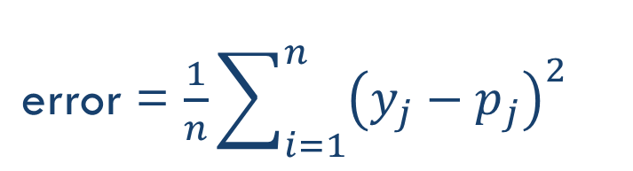
LOSS FUNCTION
1 | 0 | 0 | 0 | 0 | 0 | 0 | 0 | 0
0 | 1 | 0 | 0 | 0 | 0 | 1 | 0 | 0
0 | 0 | 1 | 0 | 0 | 1 | 0 | 0 | 0
0 | 0 | 0 | 1 | 1 | 0 | 0 | 0 | 0
0 | 0 | 0 | 1 | 1 | 0 | 0 | 0 | 0
0 | 0 | 1 | 0 | 0 | 1 | 0 | 0 | 0
0 | 1 | 0 | 0 | 0 | 0 | 1 | 0 | 0
0 | 0 | 0 | 0 | 0 | 0 | 1 | 0 | 0
0 | 0 | 0 | 0 | 0 | 0 | 0 | 0 | 0
1
0
9 pixels
error = $\frac{1}{n}\sum_{i=1}^{n}{{\left(y_{j}−p_{j}\right)}^{2}}$
9 pixels
0.75
0.25

Slide 32
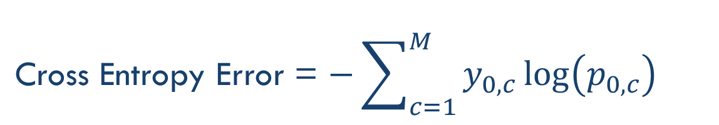
LOSS FUNCTION
1 | 0 | 0 | 0 | 0 | 0 | 0 | 0 | 0
0 | 1 | 0 | 0 | 0 | 0 | 1 | 0 | 0
0 | 0 | 1 | 0 | 0 | 1 | 0 | 0 | 0
0 | 0 | 0 | 1 | 1 | 0 | 0 | 0 | 0
0 | 0 | 0 | 1 | 1 | 0 | 0 | 0 | 0
0 | 0 | 1 | 0 | 0 | 1 | 0 | 0 | 0
0 | 1 | 0 | 0 | 0 | 0 | 1 | 0 | 0
0 | 0 | 0 | 0 | 0 | 0 | 1 | 0 | 0
0 | 0 | 0 | 0 | 0 | 0 | 0 | 0 | 0
1
0
9 pixels
Cross Entropy Error = $−\sum_{c=1}^{M}{{y_{0,c}\log\left(p_{0,c}\right)}^{}}$
9 pixels
Binary: −(y*log(p) + (1−y)*log(1−p))
0.75
0.25
Notes:
To measure that the real value is the one given with the probability

Slide 33
TRAINING
x = vector of pixels (input)
x = vector of pixels (input)
…
…
…
…
…
…
…
…
…
…
…
…
…
…
…
…
…
…
…
…
…
…
…
…
.
.
.
.
.
.
.
.
z = times(x, W) + b
cross_entropy_with_softmax(z, y)
classification_error(z, y)
…
…
…
…
…
…
…
…
(1, 0)
(0, 1)
(1, 0)
y = label vector (one-hot)
Training Data

Slide 34
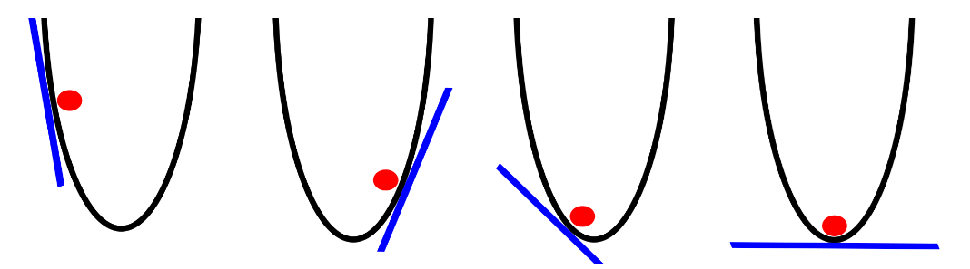
GRADIENT DESCENT

Slide 35
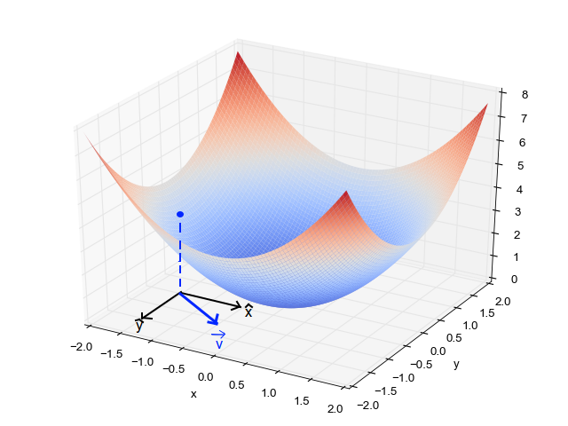
GRADIENT DESCENT

Slide 36
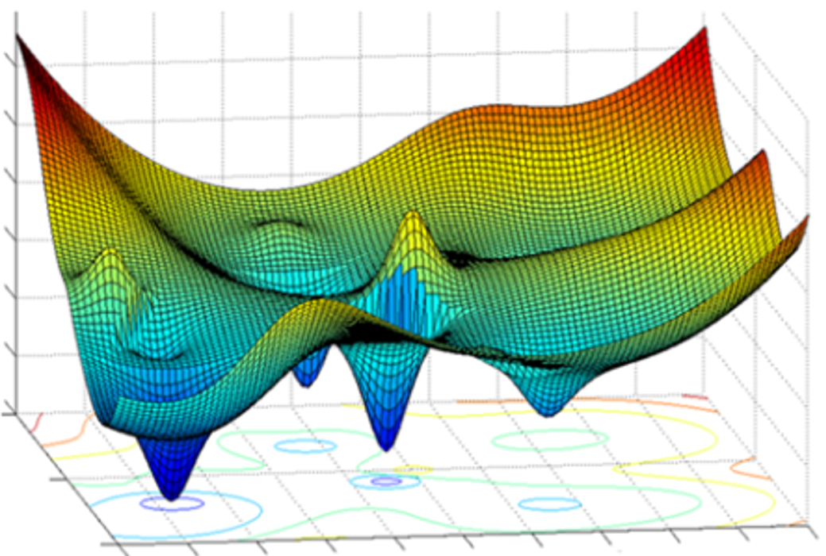
GRADIENT DESCENT

Slide 37
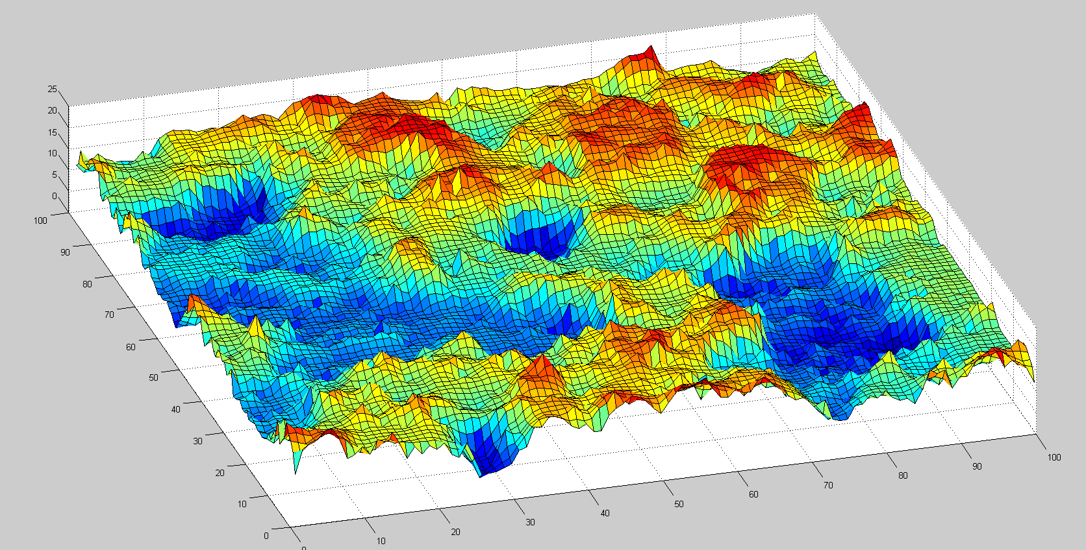
REMEMBER THIS?

Slide 38
LAB 2
Logistic Regression

Slide 39



Keras
Mission: to make building Deep architectures easier
Works on top of TensorFlow or Theano
Built by François Chollet at Google

Slide 40
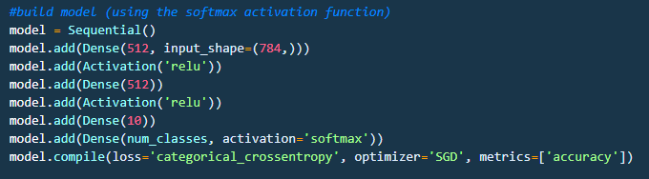
Keras
Based on layers and their input/output tensors

Slide 41
LAB 3
Logistic Regression (Keras)

Slide 42
Neural Networks

Slide 43
NEURAL NETWORK (CLASSIFIER)
Category 1
Category 2
Input Layer
Hidden Layers
Output Layer

Slide 44
NEURAL NETWORK (CLASSIFIER)
Category 1
Category 2
Input Layer
Hidden Layers
Output Layer

Slide 45
FORWARD PROPAGATION
Category 1
Category 2
Input Layer
Hidden Layers
Output Layer

Slide 46
FORWARD PROPAGATION
Category 1
Category 2
Input Layer
Hidden Layers
Output Layer

Slide 47
FORWARD PROPAGATION
Category 1
Category 2
Input Layer
Hidden Layers
Output Layer

Slide 48
FORWARD PROPAGATION
Category 1
Category 2
Input Layer
Hidden Layers
Output Layer

Slide 49
TRAINING
Cost = Generated Value – Ground Truth
Category 1
Category 2
Input Layer
Hidden Layers
Output Layer

Slide 50
BACKPROPAGATION
Cost = Generated Value – Ground Truth
Category 1
Error = X
Category 2
Input Layer
Hidden Layers
Output Layer

Slide 51
LAB 4
Multi-Layer Perceptron

Slide 52
Convolutional Networks

Slide 53
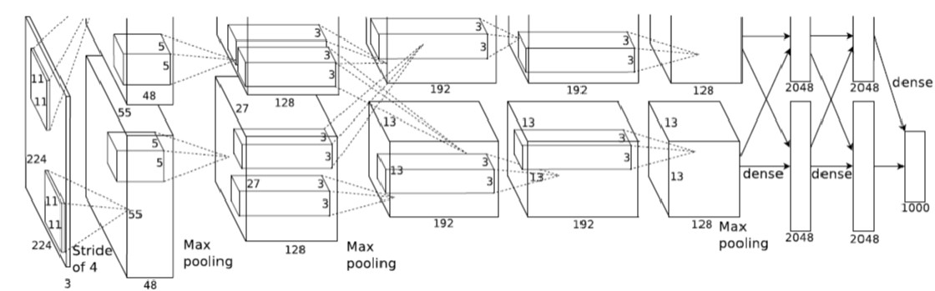
REMEMBER THIS THING?

Slide 54
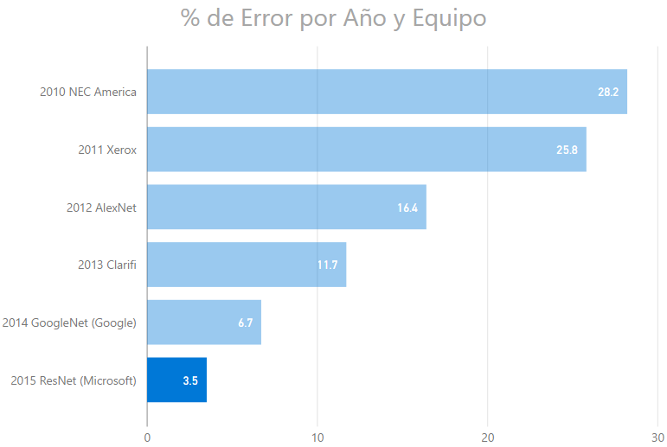
IMAGENET CHALLENGE (CLASSIFICATION)

Slide 55
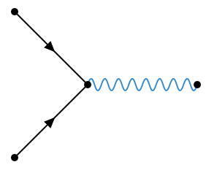
WHAT HAPPENED IN 2012?
DNNs
Deep Learning
GPUs
2012
t

Slide 56
FILTERING
0 | 0 | 0 | 0 | 0 | 0 | 0 | 0 | 0
0 | 1 | 0 | 0 | 0 | 0 | 0 | 1 | 0
0 | 0 | 1 | 0 | 0 | 0 | 1 | 0 | 0
0 | 0 | 0 | 1 | 0 | 1 | 0 | 0 | 0
0 | 0 | 0 | 0 | 1 | 0 | 0 | 0 | 0
0 | 0 | 0 | 1 | 0 | 1 | 0 | 0 | 0
0 | 0 | 1 | 0 | 0 | 0 | 1 | 0 | 0
0 | 1 | 0 | 0 | 0 | 0 | 0 | 1 | 0
0 | 0 | 0 | 0 | 0 | 0 | 0 | 0 | 0
0 | 0 | 0 | 0 | 0 | 0 | 0 | 0 | 0
0 | 0 | 0 | 0 | 0 | 0 | 1 | 0 | 0
0 | 1 | 0 | 0 | 0 | 1 | 0 | 0 | 0
0 | 0 | 1 | 1 | 0 | 1 | 0 | 0 | 0
0 | 0 | 0 | 0 | 1 | 0 | 0 | 0 | 0
0 | 0 | 0 | 1 | 0 | 1 | 1 | 0 | 0
0 | 0 | 0 | 1 | 0 | 0 | 0 | 1 | 0
0 | 0 | 1 | 0 | 0 | 0 | 0 | 0 | 0
0 | 0 | 0 | 0 | 0 | 0 | 0 | 0 | 0
0 | 0 | 0 | 0 | 0 | 0 | 0 | 0 | 0
0 | 0 | 0 | 0 | 0 | 0 | 1 | 0 | 0
0 | 1 | 0 | 0 | 0 | 1 | 0 | 0 | 0
0 | 0 | 1 | 1 | 0 | 1 | 0 | 0 | 0
0 | 0 | 0 | 0 | 1 | 0 | 0 | 0 | 0
0 | 0 | 0 | 1 | 0 | 1 | 1 | 0 | 0
0 | 0 | 0 | 1 | 0 | 0 | 0 | 1 | 0
0 | 0 | 1 | 0 | 0 | 0 | 0 | 0 | 0
0 | 0 | 0 | 0 | 0 | 0 | 0 | 0 | 0

Slide 57
FILTERING
…looking for common characteristics
Filter 1
Filter 2
Filter 3
1 | -1 | -1
-1 | 1 | -1
-1 | -1 | 1
-1 | -1 | 1
-1 | 1 | -1
1 | -1 | -1
1 | -1 | 1
-1 | 1 | -1
1 | -1 | 1
-1 | -1 | -1 | -1 | -1 | -1 | -1 | -1 | -1
-1 | 1 | -1 | -1 | -1 | -1 | -1 | 1 | -1
-1 | -1 | 1 | -1 | -1 | -1 | 1 | -1 | -1
-1 | -1 | -1 | 1 | -1 | 1 | -1 | -1 | -1
-1 | -1 | -1 | -1 | 1 | -1 | -1 | -1 | -1
-1 | -1 | -1 | 1 | -1 | 1 | -1 | -1 | -1
-1 | -1 | 1 | -1 | -1 | -1 | 1 | -1 | -1
-1 | 1 | -1 | -1 | -1 | -1 | -1 | 1 | -1
-1 | -1 | -1 | -1 | -1 | -1 | -1 | -1 | -1
1 | 1 | 1
1 | 1 | 1
1 | 1 | 1
-1 | 1 | -1
1 | 1 | 1
-1 | 1 | -1
1 | 1 | -1
1 | 1 | 1
-1 | 1 | 1
1.0
0.11
0.55

Slide 58
CONVOLUTION
Filter
-1 | -1 | -1 | -1 | -1 | -1 | -1 | -1 | -1
-1 | 1 | -1 | -1 | -1 | -1 | -1 | 1 | -1
-1 | -1 | 1 | -1 | -1 | -1 | 1 | -1 | -1
-1 | -1 | -1 | 1 | -1 | 1 | -1 | -1 | -1
-1 | -1 | -1 | -1 | 1 | -1 | -1 | -1 | -1
-1 | -1 | -1 | 1 | -1 | 1 | -1 | -1 | -1
-1 | -1 | 1 | -1 | -1 | -1 | 1 | -1 | -1
-1 | 1 | -1 | -1 | -1 | -1 | -1 | 1 | -1
-1 | -1 | -1 | -1 | -1 | -1 | -1 | -1 | -1
0.77 | -0.11 | 0.11 | 0.33 | 0.55 | -0.11 | 0.33
-0.11 | 1.00 | -0.11 | 0.33 | -0.11 | 0.11 | -0.11
0.11 | -0.11 | 1.00 | -0.33 | 0.11 | -0.11 | 0.55
0.33 | 0.33 | -0.33 | 0.55 | -0.33 | 0.33 | 0.33
0.55 | -0.11 | 0.11 | -0.33 | 1.00 | -0.11 | 0.11
-0.11 | 0.11 | -0.11 | 0.33 | -0.11 | 1.00 | -0.11
0.33 | -0.11 | 0.55 | 0.33 | 0.11 | -0.11 | 0.77
1 | -1 | -1
-1 | 1 | -1
-1 | -1 | 1

Slide 59

CONVOLUTION
-1 | -1 | -1 | -1 | -1 | -1 | -1 | -1 | -1
-1 | 1 | -1 | -1 | -1 | -1 | -1 | 1 | -1
-1 | -1 | 1 | -1 | -1 | -1 | 1 | -1 | -1
-1 | -1 | -1 | 1 | -1 | 1 | -1 | -1 | -1
-1 | -1 | -1 | -1 | 1 | -1 | -1 | -1 | -1
-1 | -1 | -1 | 1 | -1 | 1 | -1 | -1 | -1
-1 | -1 | 1 | -1 | -1 | -1 | 1 | -1 | -1
-1 | 1 | -1 | -1 | -1 | -1 | -1 | 1 | -1
-1 | -1 | -1 | -1 | -1 | -1 | -1 | -1 | -1
0.77 | -0.11 | 0.11 | 0.33 | 0.55 | -0.11 | 0.33
-0.11 | 1.00 | -0.11 | 0.33 | -0.11 | 0.11 | -0.11
0.11 | -0.11 | 1.00 | -0.33 | 0.11 | -0.11 | 0.55
0.33 | 0.33 | -0.33 | 0.55 | -0.33 | 0.33 | 0.33
0.55 | -0.11 | 0.11 | -0.33 | 1.00 | -0.11 | 0.11
-0.11 | 0.11 | -0.11 | 0.33 | -0.11 | 1.00 | -0.11
0.33 | -0.11 | 0.55 | 0.33 | 0.11 | -0.11 | 0.77
$⊗$
=
1 | -1 | -1
-1 | 1 | -1
-1 | -1 | 1

Slide 60


CONVOLUTION
-1 | -1 | -1 | -1 | -1 | -1 | -1 | -1 | -1
-1 | 1 | -1 | -1 | -1 | -1 | -1 | 1 | -1
-1 | -1 | 1 | -1 | -1 | -1 | 1 | -1 | -1
-1 | -1 | -1 | 1 | -1 | 1 | -1 | -1 | -1
-1 | -1 | -1 | -1 | 1 | -1 | -1 | -1 | -1
-1 | -1 | -1 | 1 | -1 | 1 | -1 | -1 | -1
-1 | -1 | 1 | -1 | -1 | -1 | 1 | -1 | -1
-1 | 1 | -1 | -1 | -1 | -1 | -1 | 1 | -1
-1 | -1 | -1 | -1 | -1 | -1 | -1 | -1 | -1
0.77 | -0.11 | 0.11 | 0.33 | 0.55 | -0.11 | 0.33
-0.11 | 1.00 | -0.11 | 0.33 | -0.11 | 0.11 | -0.11
0.11 | -0.11 | 1.00 | -0.33 | 0.11 | -0.11 | 0.55
0.33 | 0.33 | -0.33 | 0.55 | -0.33 | 0.33 | 0.33
0.55 | -0.11 | 0.11 | -0.33 | 1.00 | -0.11 | 0.11
-0.11 | 0.11 | -0.11 | 0.33 | -0.11 | 1.00 | -0.11
0.33 | -0.11 | 0.55 | 0.33 | 0.11 | -0.11 | 0.77
$⊗$
=
1 | -1 | -1
-1 | 1 | -1
-1 | -1 | 1
-1 | -1 | -1 | -1 | -1 | -1 | -1 | -1 | -1
-1 | 1 | -1 | -1 | -1 | -1 | -1 | 1 | -1
-1 | -1 | 1 | -1 | -1 | -1 | 1 | -1 | -1
-1 | -1 | -1 | 1 | -1 | 1 | -1 | -1 | -1
-1 | -1 | -1 | -1 | 1 | -1 | -1 | -1 | -1
-1 | -1 | -1 | 1 | -1 | 1 | -1 | -1 | -1
-1 | -1 | 1 | -1 | -1 | -1 | 1 | -1 | -1
-1 | 1 | -1 | -1 | -1 | -1 | -1 | 1 | -1
-1 | -1 | -1 | -1 | -1 | -1 | -1 | -1 | -1
$$⊗$$
0.33 | -0.11 | 0.55 | 0.33 | 0.11 | -0.11 | 0.77
-0.11 | 0.11 | -0.11 | 0.33 | -0.11 | 1.00 | -0.11
0.55 | -0.11 | 0.11 | -0.33 | 1.00 | -0.11 | 0.11
0.33 | 0.33 | -0.33 | 0.55 | -0.33 | 0.33 | 0.33
0.11 | -0.11 | 1.00 | -0.33 | 0.11 | -0.11 | 0.55
-0.11 | 1.00 | -0.11 | 0.33 | -0.11 | 0.11 | -0.11
0.77 | -0.11 | 0.11 | 0.33 | 0.55 | -0.11 | 0.33
=
-1 | -1 | 1
-1 | 1 | -1
1 | -1 | -1

Slide 61

0.77 | -0.11 | 0.11 | 0.33 | 0.55 | -0.11 | 0.33
-0.11 | 1.00 | -0.11 | 0.33 | -0.11 | 0.11 | -0.11
0.11 | -0.11 | 1.00 | -0.33 | 0.11 | -0.11 | 0.55
0.33 | 0.33 | -0.33 | 0.55 | -0.33 | 0.33 | 0.33
0.55 | -0.11 | 0.11 | -0.33 | 1.00 | -0.11 | 0.11
-0.11 | 0.11 | -0.11 | 0.33 | -0.11 | 1.00 | -0.11
0.33 | -0.11 | 0.55 | 0.33 | 0.11 | -0.11 | 0.77
1 | -1 | -1
-1 | 1 | -1
-1 | -1 | 1
-1 | -1 | -1 | -1 | -1 | -1 | -1 | -1 | -1
-1 | 1 | -1 | -1 | -1 | -1 | -1 | 1 | -1
-1 | -1 | 1 | -1 | -1 | -1 | 1 | -1 | -1
-1 | -1 | -1 | 1 | -1 | 1 | -1 | -1 | -1
-1 | -1 | -1 | -1 | 1 | -1 | -1 | -1 | -1
-1 | -1 | -1 | 1 | -1 | 1 | -1 | -1 | -1
-1 | -1 | 1 | -1 | -1 | -1 | 1 | -1 | -1
-1 | 1 | -1 | -1 | -1 | -1 | -1 | 1 | -1
-1 | -1 | -1 | -1 | -1 | -1 | -1 | -1 | -1
$$⊗$$
=
0.33 | -0.55 | -0.11 | -0.11 | 0.11 | -0.55 | 0.33
-0.55 | 0.55 | -0.55 | 0.33 | -0.55 | 0.55 | -0.55
0.11 | -0.55 | 0.55 | -0.77 | 0.55 | -0.55 | 0.11
-0.11 | 0.33 | -0.77 | 1.00 | -0.77 | 0.33 | -0.11
0.11 | -0.55 | 0.55 | -0.77 | 0.55 | -0.55 | 0.11
-0.55 | 0.55 | -0.55 | 0.33 | -0.55 | 0.55 | -0.55
0.33 | -0.55 | 0.11 | -0.11 | 0.11 | -0.55 | 0.33
1 | -1 | 1
-1 | 1 | -1
1 | -1 | 1
0.33 | -0.11 | 0.55 | 0.33 | 0.11 | -0.11 | 0.77
-0.11 | 0.11 | -0.11 | 0.33 | -0.11 | 1.00 | -0.11
0.55 | -0.11 | 0.11 | -0.33 | 1.00 | -0.11 | 0.11
0.33 | 0.33 | -0.33 | 0.55 | -0.33 | 0.33 | 0.33
0.11 | -0.11 | 1.00 | -0.33 | 0.11 | -0.11 | 0.55
-0.11 | 1.00 | -0.11 | 0.33 | -0.11 | 0.11 | -0.11
0.77 | -0.11 | 0.11 | 0.33 | 0.55 | -0.11 | 0.33
-1 | -1 | 1
-1 | 1 | -1
1 | -1 | -1

Slide 62



STRIDES AND PADDING
source: https://github.com/vdumoulin/conv_arithmetic

Slide 63
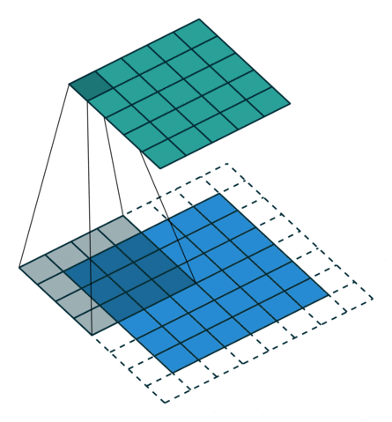

DECONVOLUTION – TRANSPOSED CONVOLUTION
source: https://github.com/vdumoulin/conv_arithmetic

Slide 64
POOLING
0.77 | -0.11 | 0.11 | 0.33 | 0.55 | -0.11 | 0.33
-0.11 | 1.00 | -0.11 | 0.33 | -0.11 | 0.11 | -0.11
0.11 | -0.11 | 1.00 | -0.33 | 0.11 | -0.11 | 0.55
0.33 | 0.33 | -0.33 | 0.55 | -0.33 | 0.33 | 0.33
0.55 | -0.11 | 0.11 | -0.33 | 1.00 | -0.11 | 0.11
-0.11 | 0.11 | -0.11 | 0.33 | -0.11 | 1.00 | -0.11
0.33 | -0.11 | 0.55 | 0.33 | 0.11 | -0.11 | 0.77

Slide 65
POOLING
0.77 | -0.11 | 0.11 | 0.33 | 0.55 | -0.11 | 0.33
-0.11 | 1.00 | -0.11 | 0.33 | -0.11 | 0.11 | -0.11
0.11 | -0.11 | 1.00 | -0.33 | 0.11 | -0.11 | 0.55
0.33 | 0.33 | -0.33 | 0.55 | -0.33 | 0.33 | 0.33
0.55 | -0.11 | 0.11 | -0.33 | 1.00 | -0.11 | 0.11
-0.11 | 0.11 | -0.11 | 0.33 | -0.11 | 1.00 | -0.11
0.33 | -0.11 | 0.55 | 0.33 | 0.11 | -0.11 | 0.77

Slide 66
AVERAGE POOLING – STRIDE 1
0.77 | -0.11 | 0.11 | 0.33 | 0.55 | -0.11 | 0.33
-0.11 | 1.00 | -0.11 | 0.33 | -0.11 | 0.11 | -0.11
0.11 | -0.11 | 1.00 | -0.33 | 0.11 | -0.11 | 0.55
0.33 | 0.33 | -0.33 | 0.55 | -0.33 | 0.33 | 0.33
0.55 | -0.11 | 0.11 | -0.33 | 1.00 | -0.11 | 0.11
-0.11 | 0.11 | -0.11 | 0.33 | -0.11 | 1.00 | -0.11
0.33 | -0.11 | 0.55 | 0.33 | 0.11 | -0.11 | 0.77
0.39 | 0.22 | 0.17 | 0.28 | 0.11 | 0.06
0.22 | 0.45 | 0.22 | 0.00 | 0.00 | 0.11
0.17 | 0.22 | 0.22 | 0.00 | 0.00 | 0.28
0.28 | 0.00 | 0.00 | 0.22 | 0.22 | 0.17
0.11 | 0.00 | 0.00 | 0.22 | 0.45 | 0.22
0.06 | 0.11 | 0.28 | 0.17 | 0.22 | 0.39

Slide 67
MAX POOLING – STRIDE 1
0.77 | -0.11 | 0.11 | 0.33 | 0.55 | -0.11 | 0.33
-0.11 | 1.00 | -0.11 | 0.33 | -0.11 | 0.11 | -0.11
0.11 | -0.11 | 1.00 | -0.33 | 0.11 | -0.11 | 0.55
0.33 | 0.33 | -0.33 | 0.55 | -0.33 | 0.33 | 0.33
0.55 | -0.11 | 0.11 | -0.33 | 1.00 | -0.11 | 0.11
-0.11 | 0.11 | -0.11 | 0.33 | -0.11 | 1.00 | -0.11
0.33 | -0.11 | 0.55 | 0.33 | 0.11 | -0.11 | 0.77
1.00 | 1.00 | 0.33 | 0.55 | 0.55 | 0.33
1.00 | 1.00 | 1.00 | 0.33 | 0.11 | 0.55
0.33 | 1.00 | 1.00 | 0.55 | 0.33 | 0.55
0.55 | 0.33 | 0.55 | 1.00 | 1.00 | 0.33
0.55 | 0.11 | 0.33 | 1.00 | 1.00 | 1.00
0.33 | 0.55 | 0.55 | 0.33 | 1.00 | 1.00

Slide 68
AVERAGE POOLING – STRIDE 2
0.77 | -0.11 | 0.11 | 0.33 | 0.55 | -0.11 | 0.33
-0.11 | 1.00 | -0.11 | 0.33 | -0.11 | 0.11 | -0.11
0.11 | -0.11 | 1.00 | -0.33 | 0.11 | -0.11 | 0.55
0.33 | 0.33 | -0.33 | 0.55 | -0.33 | 0.33 | 0.33
0.55 | -0.11 | 0.11 | -0.33 | 1.00 | -0.11 | 0.11
-0.11 | 0.11 | -0.11 | 0.33 | -0.11 | 1.00 | -0.11
0.33 | -0.11 | 0.55 | 0.33 | 0.11 | -0.11 | 0.77
1.00 | 0.33 | 0.55 | 0.33
0.33 | 1.00 | 0.33 | 0.55
0.55 | 0.33 | 1.00 | 0.11
0.33 | 0.55 | 0.11 | 0.77

Slide 69
WHY POOLING?

Slide 70
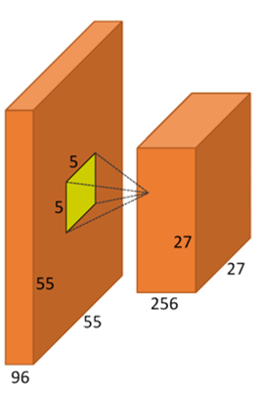
ACTIVATION FUNCTIONS?

Slide 71
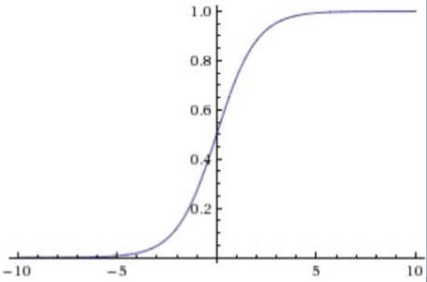
ACTIVATION FUNCTIONS?
LOGISTIC FUNCTION (“sigmoid”):
Simple
Drawbacks:
Saturates
Non-centered in zero
We don’t use it anymore, but we thank her for the services provided to the cause :)

Slide 72
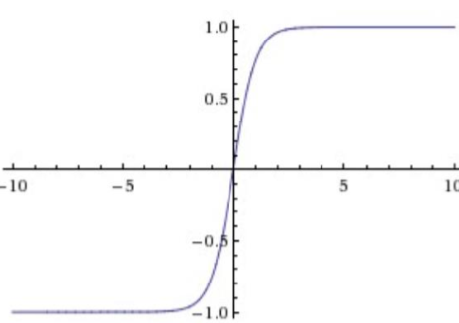
ACTIVATION FUNCTIONS?
HYPERBOLIC TANGENT (tanh):
Solves the issue with not being centered in zero
Still ‘killing gradients’ due to saturating behaviouir
It is always better than the logistic function

Slide 73
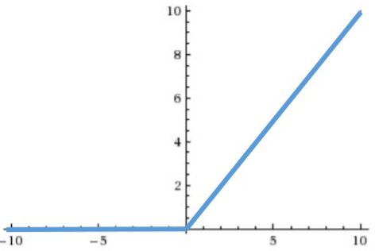
ACTIVATION FUNCTIONS?
RECTIFIED LINEAR UNITS (ReLU):
Optimization for the SGD convergence
More simple from a computational point of view
Fragile

Slide 74
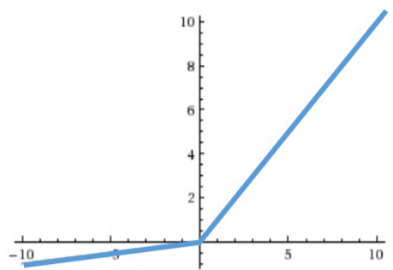
ACTIVATION FUNCTIONS?
LEAKY ReLU:
More stable than traditional ReLu
Particular case of MaxOut

Slide 75
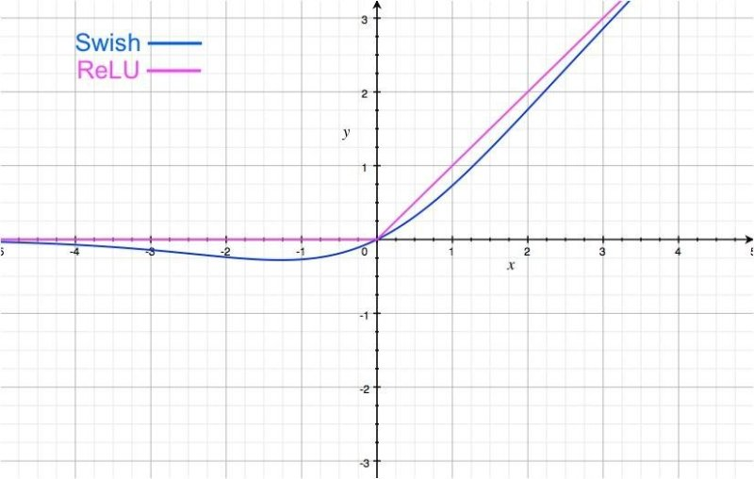
ACTIVATION FUNCTIONS?
SWISH:
Self-Gating activation function
Better performance than ReLu

Slide 76
RECTIFIED LINEAR UNITS (ReLU)
0.77 | -0.11 | 0.11 | 0.33 | 0.55 | -0.11 | 0.33
-0.11 | 1.00 | -0.11 | 0.33 | -0.11 | 0.11 | -0.11
0.11 | -0.11 | 1.00 | -0.33 | 0.11 | -0.11 | 0.55
0.33 | 0.33 | -0.33 | 0.55 | -0.33 | 0.33 | 0.33
0.55 | -0.11 | 0.11 | -0.33 | 1.00 | -0.11 | 0.11
-0.11 | 0.11 | -0.11 | 0.33 | -0.11 | 1.00 | -0.11
0.33 | -0.11 | 0.55 | 0.33 | 0.11 | -0.11 | 0.77
0.77 | 0.00 | 0.11 | 0.33 | 0.55 | 0.00 | 0.33
0.00 | 1.00 | 0.00 | 0.33 | 0.00 | 0.11 | 0.00
0.11 | 0.00 | 1.00 | 0.00 | 0.11 | 0.00 | 0.55
0.33 | 0.33 | 0.00 | 0.55 | 0.00 | 0.33 | 0.33
0.55 | 0.00 | 0.11 | 0.00 | 1.00 | 0.00 | 0.11
0.00 | 0.11 | 0.00 | 0.33 | 0.00 | 1.00 | 0.00
0.33 | 0.00 | 0.55 | 0.33 | 0.11 | 0.00 | 0.77

Slide 77
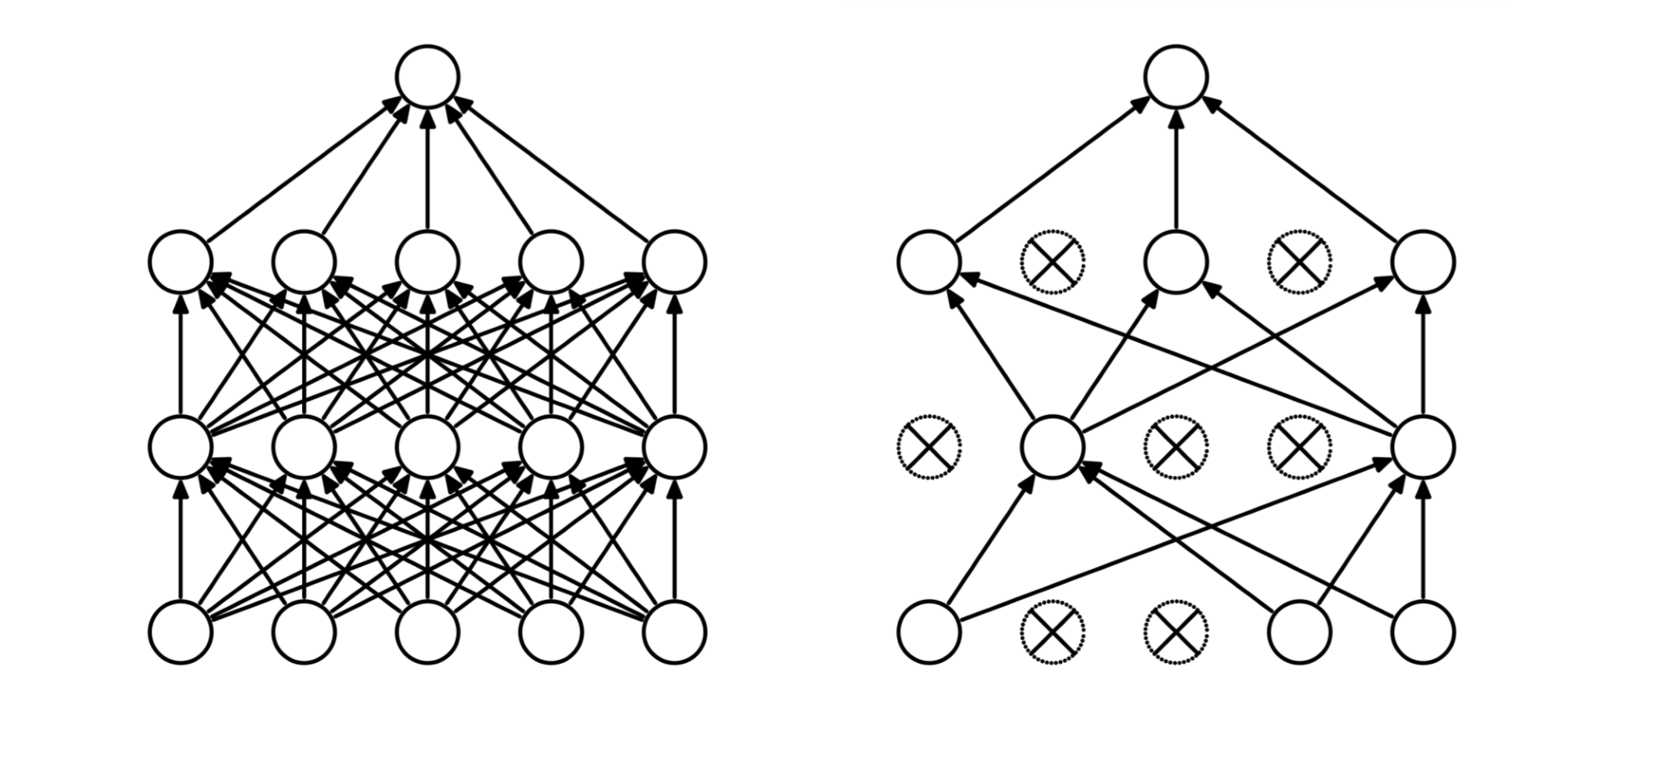
DROPOUT

Slide 78
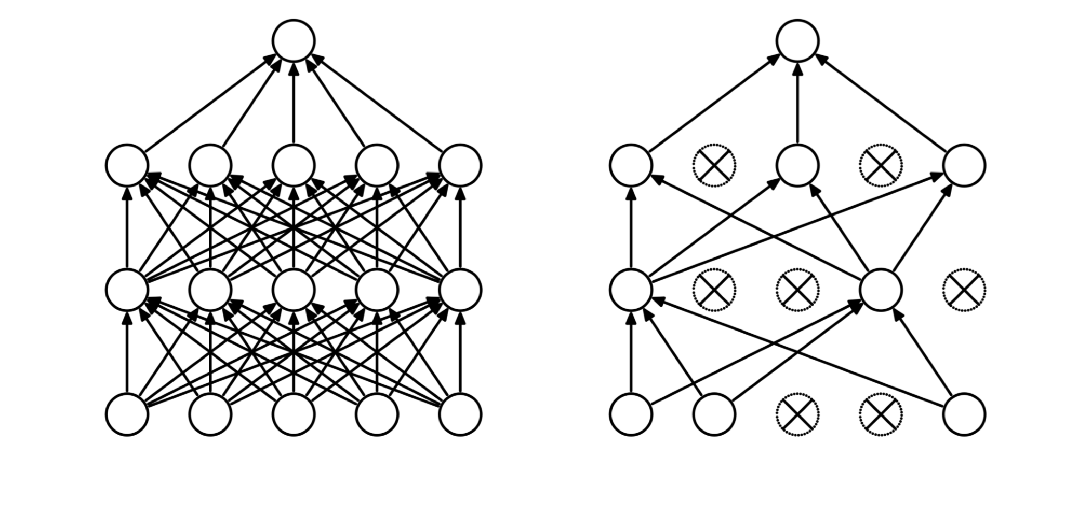
DROPOUT

Slide 79
WHAT IS MISSING?
Filter 1
Filter 2
Filter 3
1 | -1 | -1
-1 | 1 | -1
-1 | -1 | 1
-1 | -1 | 1
-1 | 1 | -1
1 | -1 | -1
1 | -1 | 1
-1 | 1 | -1
1 | -1 | 1
How have these filters been selected/created?

Slide 80
AlexNet

Slide 81
HOW A CNN SEES

Slide 82
HOW A CNN SEES

Slide 83
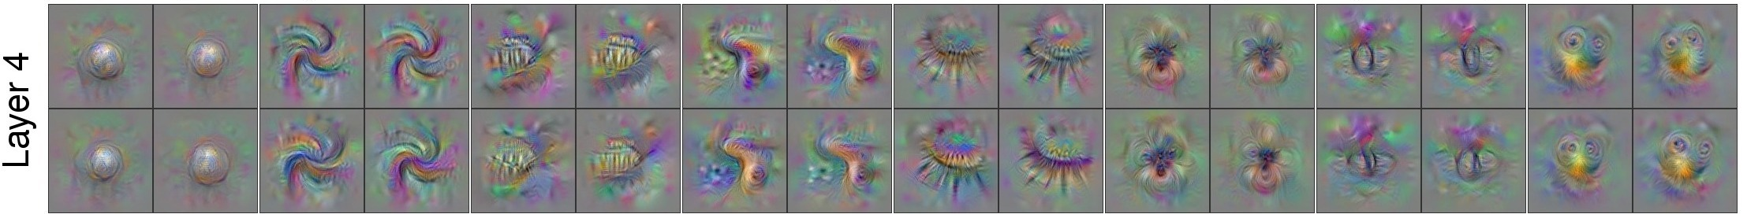
HOW A CNN SEES

Slide 84
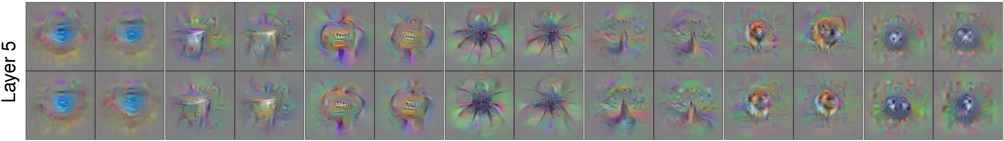
HOW A CNN SEES

Slide 85
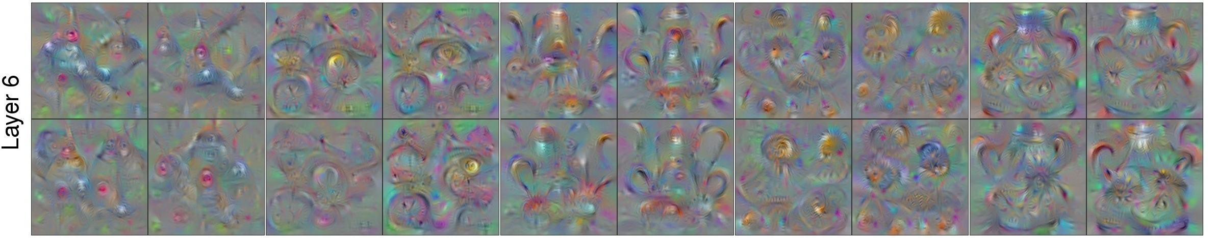
HOW A CNN SEES

Slide 86
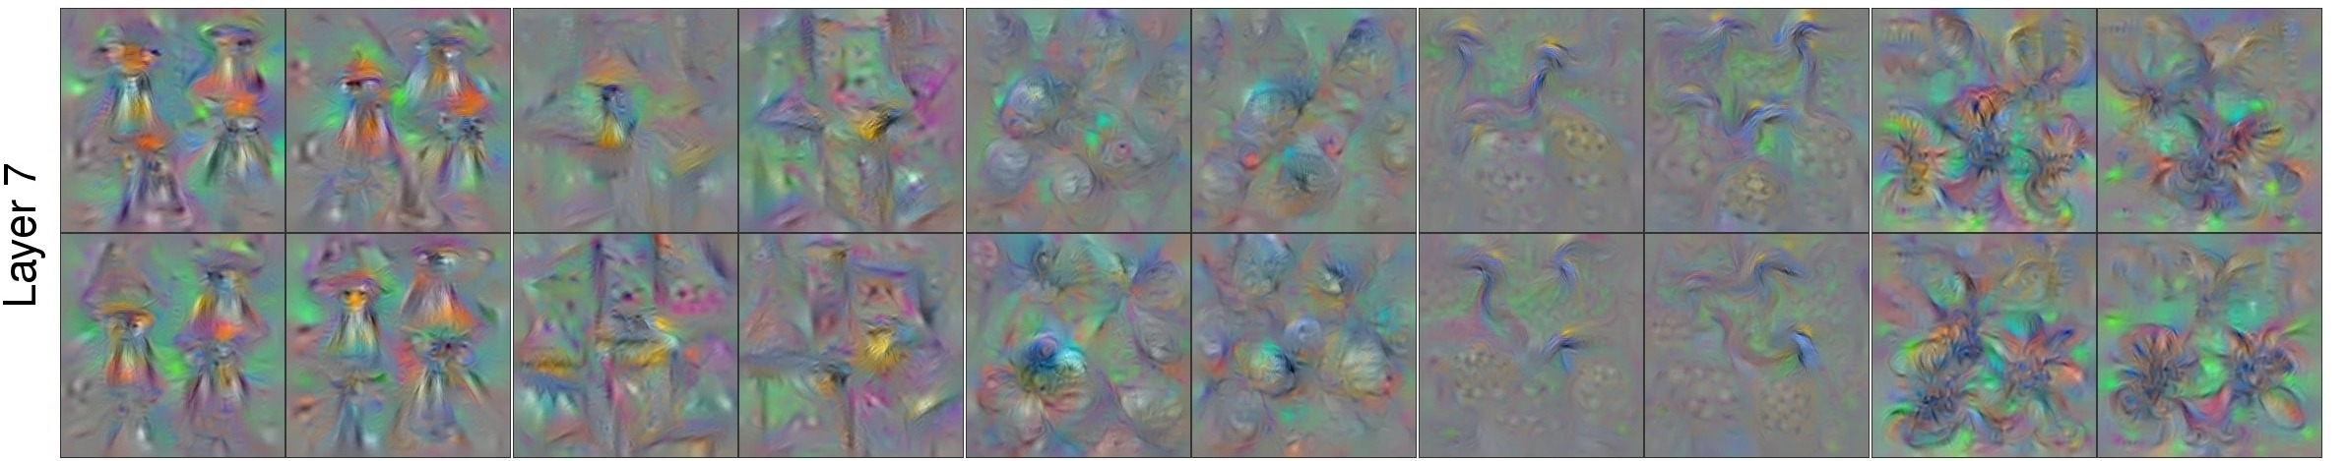
HOW A CNN SEES

Slide 87
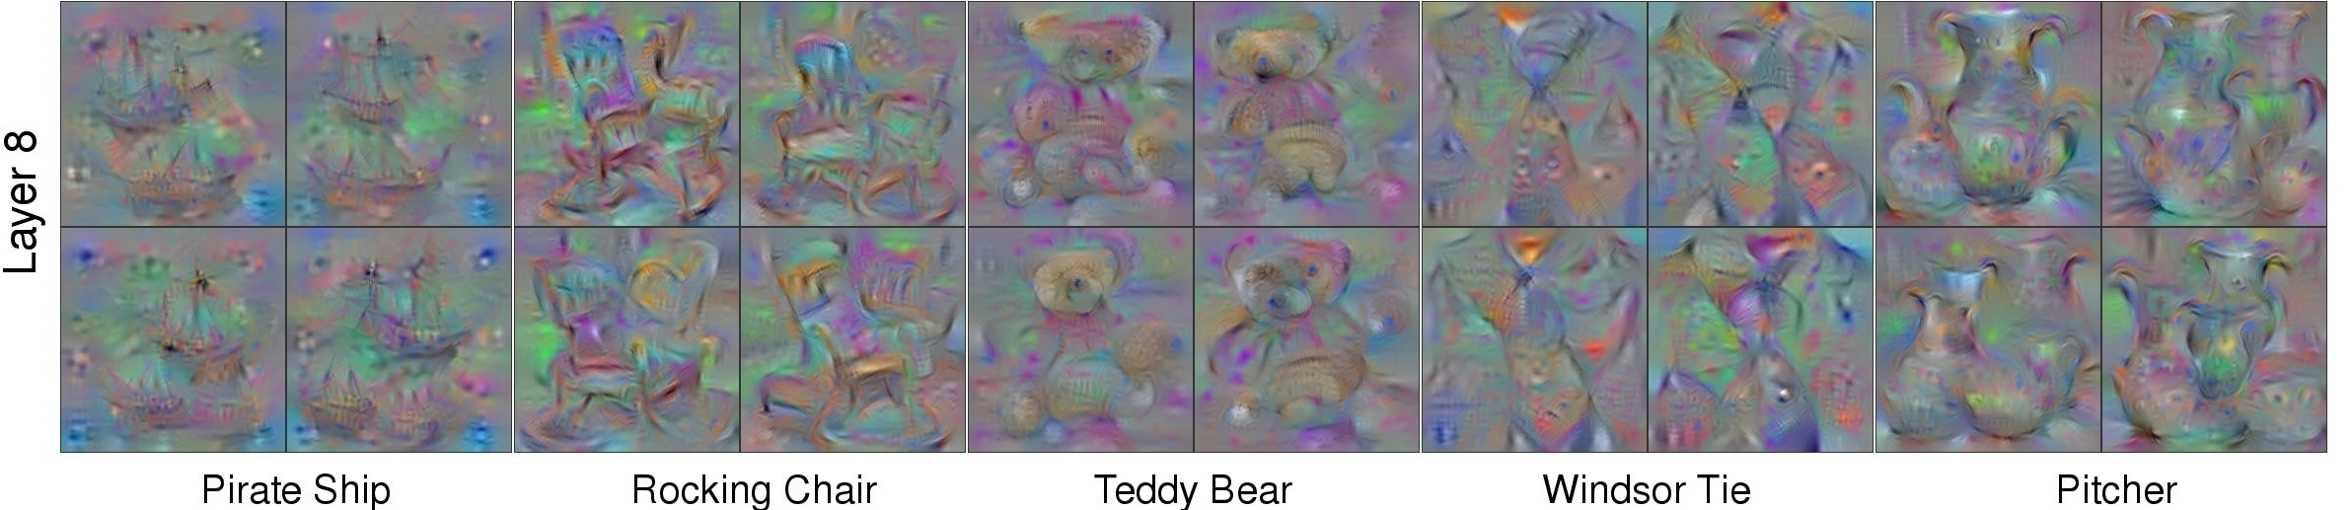
HOW A CNN SEES

Slide 88
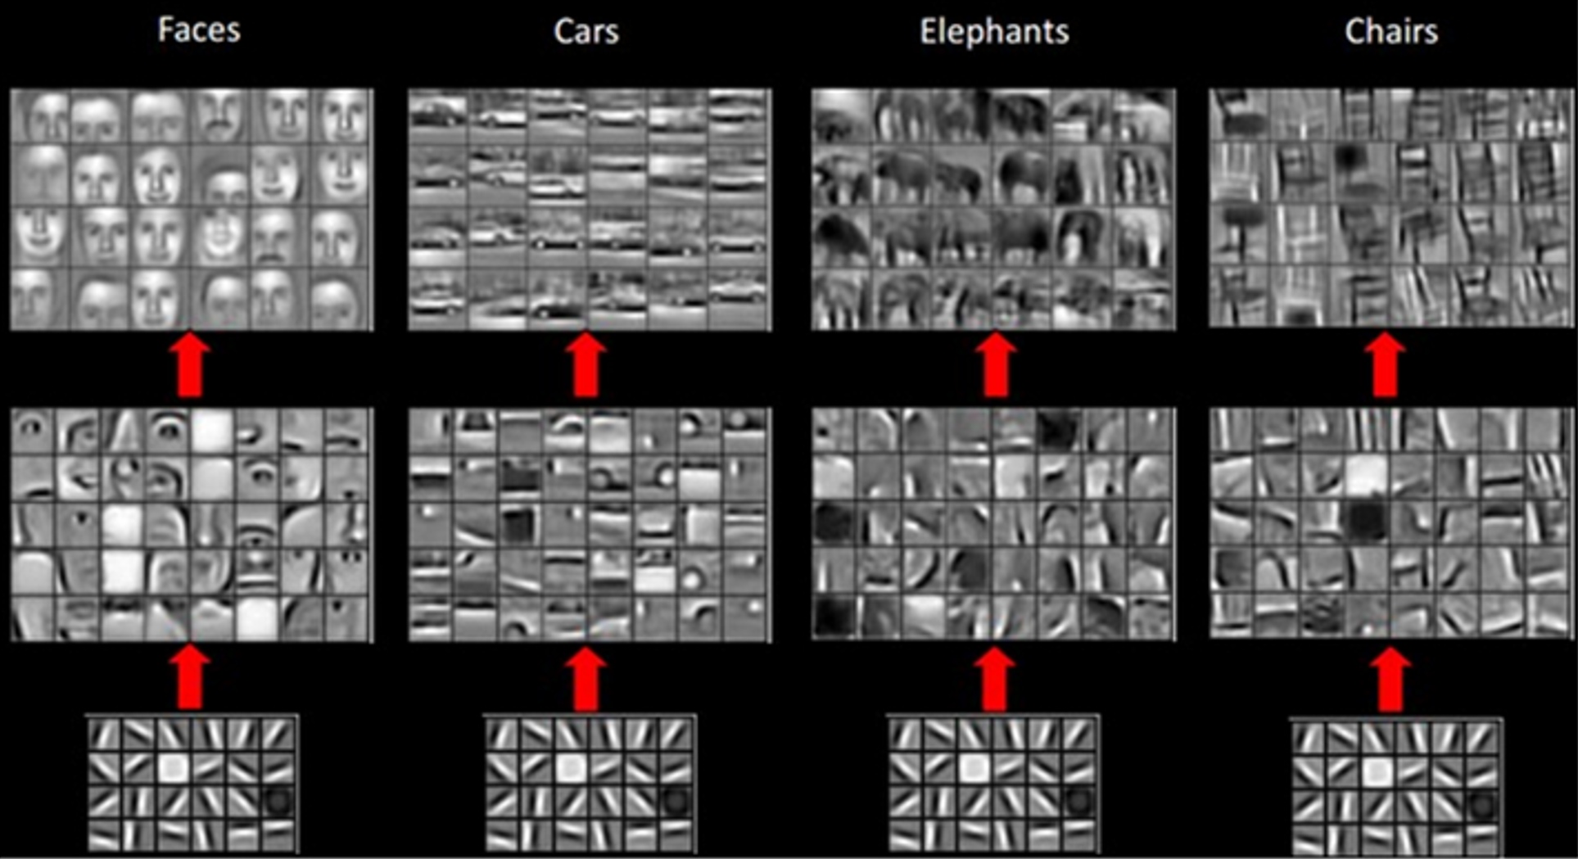

Slide 89
LAB 5
Convolutional Networks

Slide 90
Autoencoders

Slide 91
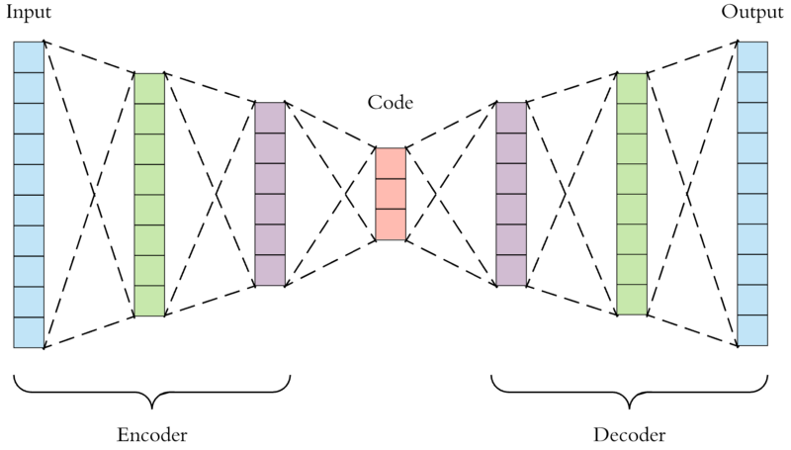


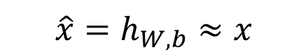
BASIC AUTOENCODER
$$\hat{x}=h_{W,b}≈x$$

Slide 92
Recurrent Neural Networks

Slide 93
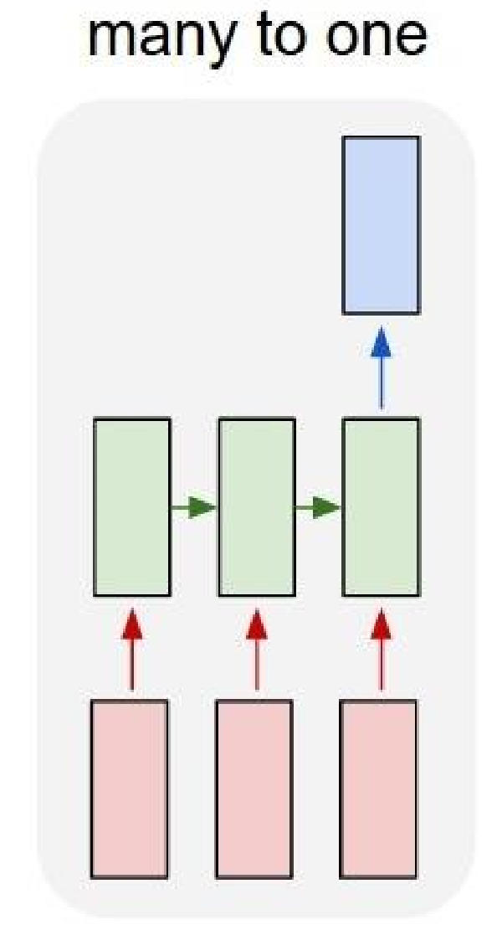
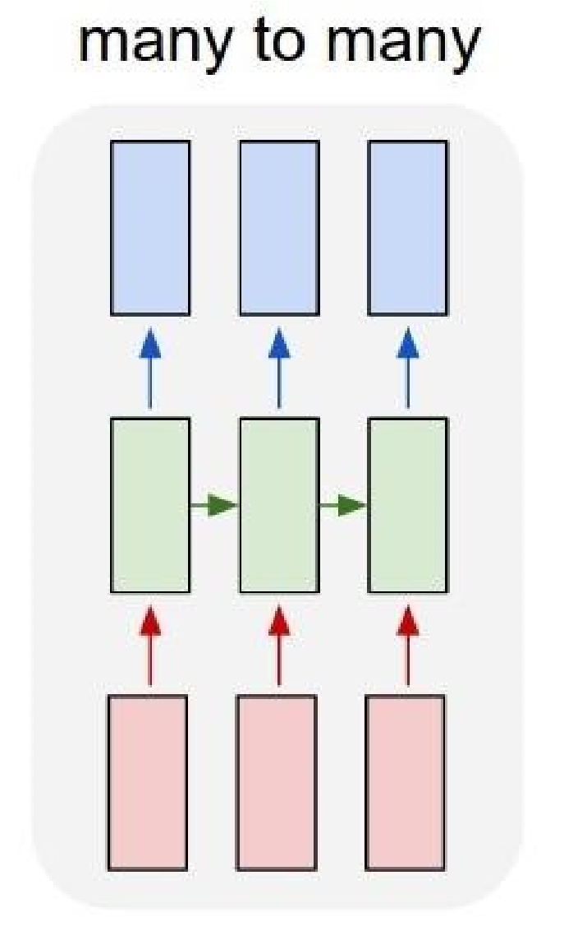
HANDLING SEQUENCES

Slide 94
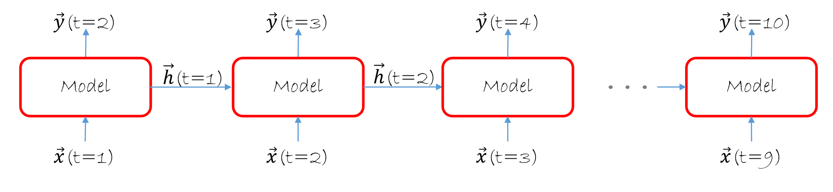
TRACKING THE HISTORY

Slide 95
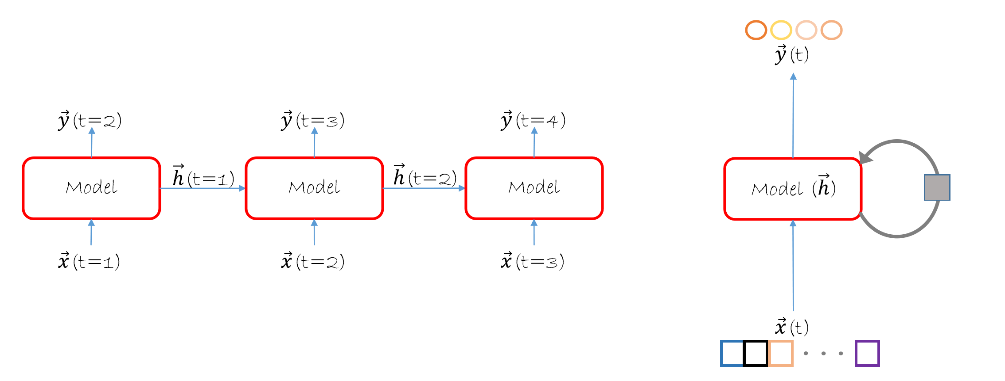
RECURRENCE

Slide 96


Slide 97

LONG SHORT TERM MEMORY

Slide 98


Slide 99


Slide 100


Slide 101


Slide 102
Some Advanced Ideas

Slide 103

Counting people in a multitude
CONTEXTUAL PYRAMID CNN (CP-CNN)
A new method named Contextual Pyramid CNN (CP-CNN) is proposed here to generate density maps and influx estimations, by explicitely incorporating global and local context information. Composed of four modules: Global Context Estimator (GCE), Local Context Estimator (LCE), Density Map Estimator (DME) and a Fusion-CNN (F-CNN) convolutional network.
Vishwanath A. Sindagi, Vishal M. Patel; The IEEE International Conference on Computer Vision (ICCV), 2017, pp. 1861-1870

Slide 104


Slide 105


Slide 106


Slide 107
Transferring style between images
CONVOLUTIONAL NEURAL NETWORKS
By using a perceptual loss functions based on high-level features extracted from pretrained networks, networks for image transformation tasks can be trained, and by fine tuning the loss function different features can be kept for the source image and the style image.
Justin Johnson, Alexandre Alahi, Li Fei-Fei; Perceptual Losses for Real-Time Style Transfer and Super-Resolution, 2016

Slide 108


Slide 109



Slide 110


Slide 111

Using GANs to drive design decisions
GENERATIVE ADVERSARIAL NETWORKS
By taking advantage of Generational Adversarial Networks, synthetic images based on the training data can be generated. Including an external array of features, the generated images can be tailored to a specific set of requirements.
Jaime Deverall, Jiwoo Lee, Miguel Ayala; Using Generative Adversarial Networks to Design Shoes

Slide 112


Slide 113


Slide 114


Slide 115

HOW DOES THIS WORK?

Slide 116


MOVING FAST!

Slide 117

MOVING FAST!

Slide 118
SOME INTERESTING PAPERS
“ImageNet Classification with Deep Convolutional Neural Netowrks”
[Krizhevsky, Sutskever, Hinton]
http://www.cs.toronto.edu/~fritz/absps/imagenet.pdf
“Visualizing and Understanding Convolutional Networks”
[Zeiler, Fergus]
arXiv: 1311.2901v3
“Optimization Methods for Large-Scale Machine Learning”
[Bottou, Curtis, Nocedal]
arXiv: 1606.04838v2

Slide 119
SOME INTERESTING PAPERS
“Swish: A Self-Gated Activation Function”
[Ramachandran, Zoph, Quoc V.]
arXiv: 1710.05941v2
“Dynamic Routing Between Capsules”
[Sabour, Frosst, Hinton]
arXiv: 1710.09829

